Slide 1
Project Title
Retail Sales Forecasting & Demand Prediction
Name: Bhagyashree sahoo
Industry: Retail

Slide 2
Project Overview
From raw M5 retail data to forecasting, dashboards and business recommendations.
Industry
Retail / Sales / Supply Chain
Demand forecasting and inventory planning
Dataset
M5 Walmart retail forecasting dataset
Sales + calendar + price information
Core Outcome
Understand historical demand and build a predictive model for sales forecasting.
End-to-End Workflow
Excel documentation → Snowflake data engineering & SQL → Databricks/Python transformation & modelling → Power BI business dashboards → Streamlit application → GitHub project delivery

Slide 3
Business Problem
Why demand forecasting matters in retail
Demand uncertainty
Retailers must estimate demand across thousands of product-store combinations.
Inventory risk
Overestimating demand can create excess stock and holding costs.
Stockout risk
Underestimating demand can cause stockouts, lost sales and poor customer availability.
• The project uses historical sales, pricing and calendar information to analyze demand patterns.
• The objective is to create a data-driven forecasting workflow that can support inventory and replenishment planning.

Slide 4
Business Objective
What the project is designed to achieve
01 Analyze demand
Understand product, store, category and time-based sales patterns.
02 Find demand drivers
Study price, calendar and event-related effects.
03 Prepare data
Convert wide daily sales into an analysis-ready structure.
04 Build model
Use historical demand features with a Random Forest model.
05 Evaluate
Measure forecasting error using MAE and RMSE.
06 Support planning
Translate findings into inventory and demand-planning actions.

Slide 5
Business Questions
Questions addressed through descriptive, diagnostic and predictive analysis
• Which products and stores generate the highest demand?
• Which categories and departments contribute most to sales?
• How does demand change over time?
• Does selling price have an observable relationship with sales?
• Do events and calendar periods affect demand?
• Which demand patterns can be used for forecasting?
• How accurately does the predictive model estimate the evaluation-period sales?

Slide 6
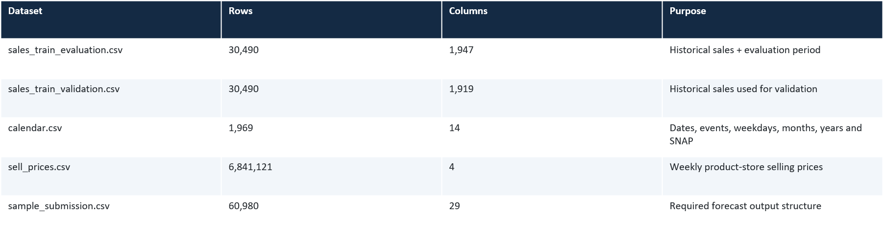
Dataset Overview
Scale: the sales files are extremely wide, with one column per daily observation. This structure is transformed before modelling.

Slide 7
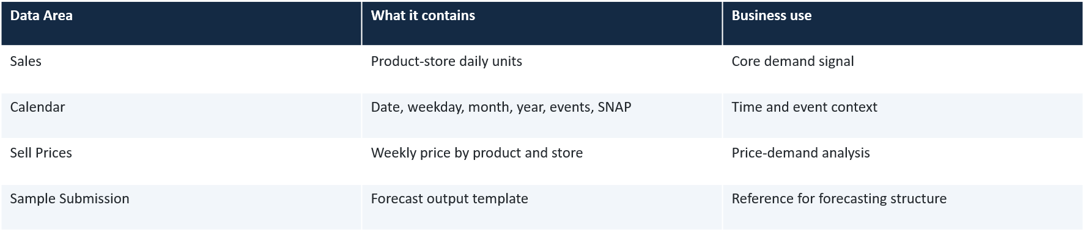
Data Description
Role of each source file in the analysis
Key challenge
The original sales data is in wide format: d_1, d_2, … d_n.
Transformation need
Daily sales columns are reshaped and mapped to calendar dates before analysis.

Slide 8
Data Dictionary
Key variables used across sales, calendar and pricing data
Variable | Meaning | Business relevance
id | Product-store series identifier | Forecasting series
item_id | Product identifier | Product-level analysis
dept_id | Department identifier | Department performance
cat_id | Category identifier | Category performance
store_id | Store identifier | Store performance
state_id | State identifier | Regional patterns
d_1 … d_n | Daily unit sales | Historical demand
date | Calendar date | Time-series analysis
wm_yr_wk | Year-week key | Links price to calendar/sales
event_name_1 | Primary event / holiday | Event impact
sell_price | Weekly selling price | Price-demand relationship

Slide 9
Data Relationships / ER Diagram
Logical relationship between the main M5 data structures
CALENDAR
d • date • weekday • month
year • events • SNAP
SALES TRAIN
id • item_id • store_id
cat_id • dept_id • d_1…d_n
SELL PRICES
store_id • item_id
wm_yr_wk • sell_price
d → date
Unpivot daily columns
item + store + week
SALES_DAILY
id • item_id • store_id
date • sales
SALES_DAILY_ENRICHED
sales + calendar + price
features for modelling
Join / enrich

Slide 10
Technology Stack
Tool selected for each stage of the workflow
Excel
Initial data review, documentation, data dictionary and relationships
Snowflake
Cloud data storage, SQL transformations, joins and analytical tables
Databricks / Python
Data transformation, feature preparation, modelling and evaluation
Power BI
Interactive business dashboards and KPI reporting
Streamlit
Interactive application for project demonstration
GitHub
Version control and centralized project delivery

Slide 11
End-to-End Data & Analytics Workflow
How the project moves from raw data to business output
01
M5 CSVs
02
Excel
Documentation
03
Snowflake
RAW + SQL
04
Daily
Transformation
05
Calendar +
Price Join
06
Databricks
Model
07
Power BI +
Streamlit
08
Business
Insights
Core transformation
Wide sales data → long daily sales → calendar mapping → weekly price integration → enriched modelling dataset → forecast + dashboards

Slide 12
Excel – Data Documentation
First stage: understand and document the raw data before engineering
Project Overview
Documented the business problem, objective, industry and project scope.
File Overview
Recorded source files, row/column counts and their purpose.
Data Dictionary
Documented key fields and their business relevance.
Data Relationships
Mapped how sales, calendar and price information connect.
Initial Observations
Recorded structural observations before SQL processing.

Slide 13
Snowflake – Data Engineering & SQL Analysis
Cloud data layer used for loading, transformation and analytical preparation
RAW
Source Tables
SALES_DAILY
58.3M rows
CALENDAR +
PRICE JOIN
ENRICHED SALES
58.3M rows
• Created RETAIL_FORECASTING database with RAW, CLEAN and ANALYTICS schemas.
• Loaded calendar, sales, price and submission files.
• Unpivoted daily sales columns into SALES_DAILY.
• Mapped all daily sales observations to calendar dates with 0 unmatched date records.
• Joined weekly prices using item_id + store_id + wm_yr_wk.
• Created analytical tables for daily, monthly, product, category, department, store, event, price and forecasting analysis.

Slide 14
Databricks / Python – Transformation & Forecasting
Notebook-based analysis and predictive modelling
1. Load & inspect
Read prepared M5 data from the managed volume and validate structures.
2. Feature preparation
Create daily demand, time-based and modelling-ready features.
3. Model
Train a Random Forest Regressor using historical demand features.
4. Evaluate
Compare predictions with actual sales using MAE and RMSE.
5. Export
Save forecast, evaluation and Power BI-ready CSV outputs.

Slide 15
Descriptive Analysis
What happened in the historical sales data?
Overall volume
Approximately 66M units sold in the analyzed daily sales data.
Top product
FOODS_3_090 generated 1,002,529 units.
Top store
CA_3 generated 1,118,180 units.
Leading department
FOODS_3 generated 32,372,076 units.
Analysis dimensions
Daily, monthly, product, category, department, store and state.
• Power BI visuals were used to make these patterns easier to interpret at business level.

Slide 16
Diagnostic Analysis
Why did demand vary?
Price vs Sales
Compared selling price with daily sales to examine price-demand association.
Events
Compared event-day and normal-day demand.
Store Differences
Examined demand variation across stores and states.
Calendar Effects
Analyzed weekday, month and time-based patterns.
Category Patterns
Compared demand behavior across product categories.
SNAP Context
Included SNAP indicators available in the calendar data.

Slide 17
Predictive Analysis – Demand Forecasting
How historical demand was used to estimate sales
Historical
Demand
Time & Demand
Features
Random Forest
Regressor
Predicted Sales
Evaluation Period
Model
Random Forest Regressor trained using historical demand features.
Important interpretation
The available forecast output represents an evaluation-period prediction; it should not be described as a true recursive 28-day future forecast.

Slide 18
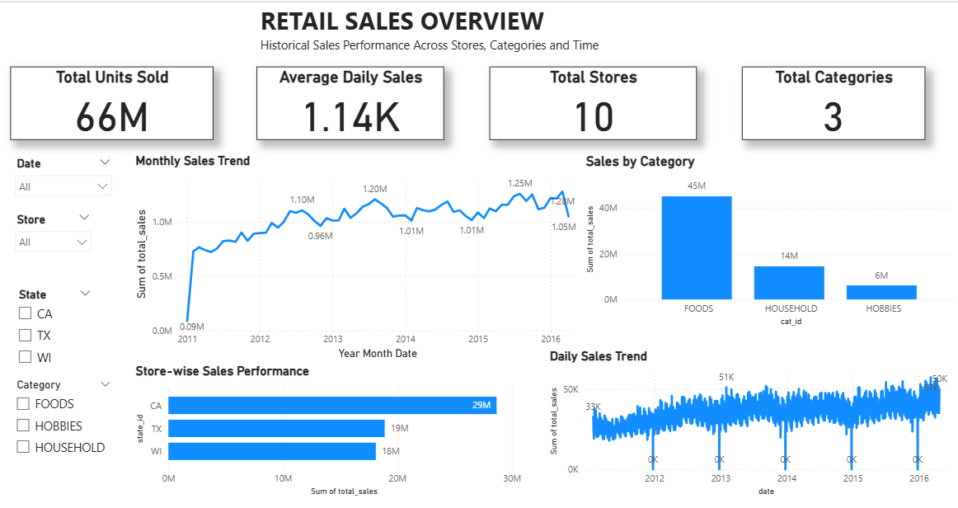
Power BI Dashboard 1 – Retail Sales Overview
Historical sales performance across stores, categories and time.
Dashboard focus
• Monthly Sales Trend
• Sales by Category
• Store-wise Sales Performance
• Daily Sales Trend
• Slicers: Date, State, Store, Category

Slide 19
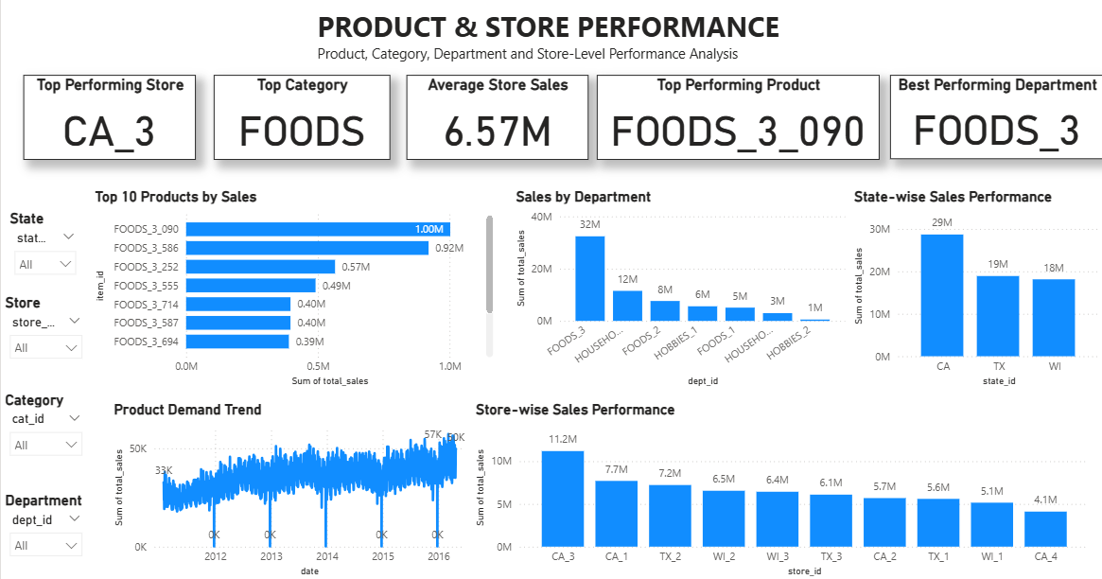
Power BI Dashboard 2 – Product & Store Performance
Product, department, category and store-level performance analysis.
Dashboard focus
• Top 10 Products
• Sales by Department
• Store-wise Performance
• State-wise Performance
• Product Demand Trend
• Slicers: State, Store, Category, Department

Slide 20
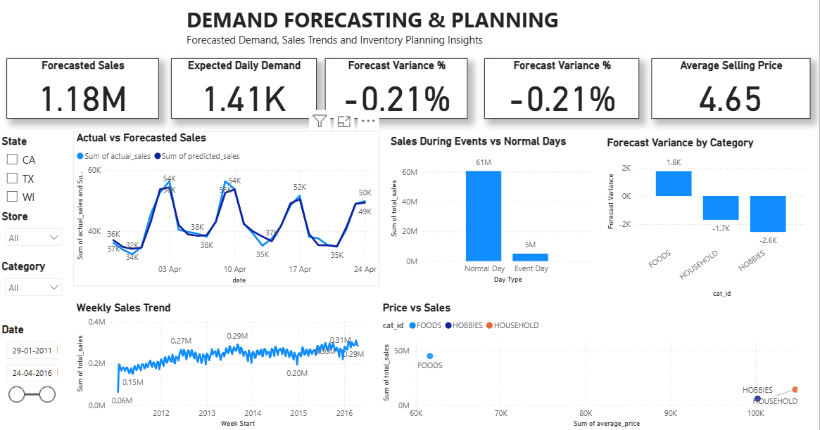
Power BI Dashboard 3 – Demand Forecasting & Planning
Forecasted demand, sales trends and planning indicators.
Dashboard focus
• Actual vs Forecasted Sales
• Weekly Sales Trend
• Event vs Normal Days
• Price vs Sales
• Forecast Variance by Category
• Slicers: State, Store, Category, Date

Slide 21
Streamlit Application
Interactive project demonstration built from the Power BI-ready analytical outputs
CSV Outputs
Python +
Streamlit
Filters +
KPIs
Interactive
Charts
• Sidebar filters for State, Store and Category.
• KPIs for total units, stores, categories and forecasted sales.
• Daily/monthly trends, category/store performance, events, actual vs forecast, variance, price vs sales, products and departments.
• Model evaluation metrics displayed for transparency.

Slide 22
GitHub – Project Delivery
Centralized project structure for reproducibility and submission
01_Excel/
M5_Data_Documentation.xlsx
02_Snowflake/
01_M5_Snowflake_Analysis.sql
03_Databricks/
Retail Demand Forecasting.py
04_PowerBI/
Final .pbix
05_Streamlit/
app.py + requirements.txt + data/
06_Presentation/
Presentation files
07_Documentation/
Project documentation

Slide 23
Key Business Insights
What the analysis tells the business
• Demand is highly granular across products and stores, so product-store level analysis is important.
• Approximately 66M units were sold in the analyzed daily sales data.
• FOODS_3_090 was the highest-selling product with 1,002,529 units.
• CA_3 was the highest-selling store with 1,118,180 units.
• FOODS_3 was the leading department with 32,372,076 units.
• Price, calendar and event variables provide useful context for explaining demand variation.
• The predictive model provides a measurable baseline for forecast-driven planning.

Slide 24
Business Recommendations
How the analysis can support retail decision-making
Inventory
Use product-store demand signals to prioritize replenishment.
High-volume items
Monitor top-selling products closely to reduce stockout risk.
Store planning
Use store-level patterns to allocate inventory more effectively.
Pricing
Review price-demand relationships before major pricing changes.
Events
Plan inventory around seasonal and event-driven demand changes.
Model governance
Track forecast error and retrain when demand patterns change.

Slide 25
Project Conclusion
End-to-end outcome
• The project converted a large, wide retail forecasting dataset into analysis-ready daily sales data.
• Snowflake provided the structured SQL/data-engineering layer for transformation and enrichment.
• Databricks and Python were used for predictive modelling and evaluation.
• Power BI translated the analysis into business-facing dashboards.
• Streamlit provided an interactive application for demonstrating the project outputs.
• Overall, the workflow creates a foundation for data-driven demand planning, inventory management and retail decision-making.

Slide 26
THANK YOU

